Slide 1
Comp3000 Project: Netmanager – NCM Application
James White

Slide 2
Project Idea
Network Configuration & Management Application for automated configuration, management and monitoring of a network
Includes additional security automation for implementing network security features (e.g. access lists, port security etc.) based on set security polices
User will be able to log in to view and manage the network through the GUI avoiding direct access to network devices

Slide 3
Program Architecture
Frontend:
Web Application using the Django Web Framework & Bootstrap
Controller:
Python programmed API for handling network functions between the GUI and the network
Backend:
Virtual network running in GNS3

Slide 4

Current Progress & Issues
Progress:
Frontend Development
Django Python Web Application
Started designing and building the web pages
Backend development
Ubuntu server with:
GNS3 Remote Server Django/Gunicorn Web Server
Issues:
GNS3 Remote Server

Slide 5
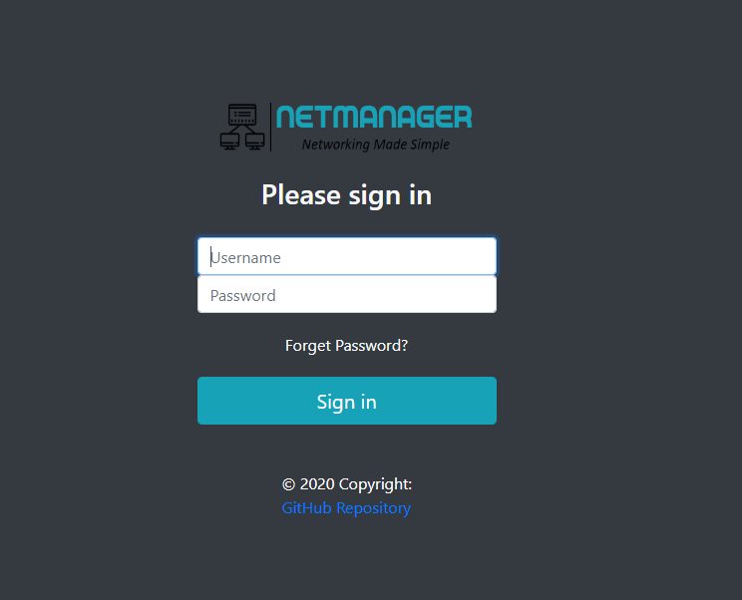
Login Page

Slide 6
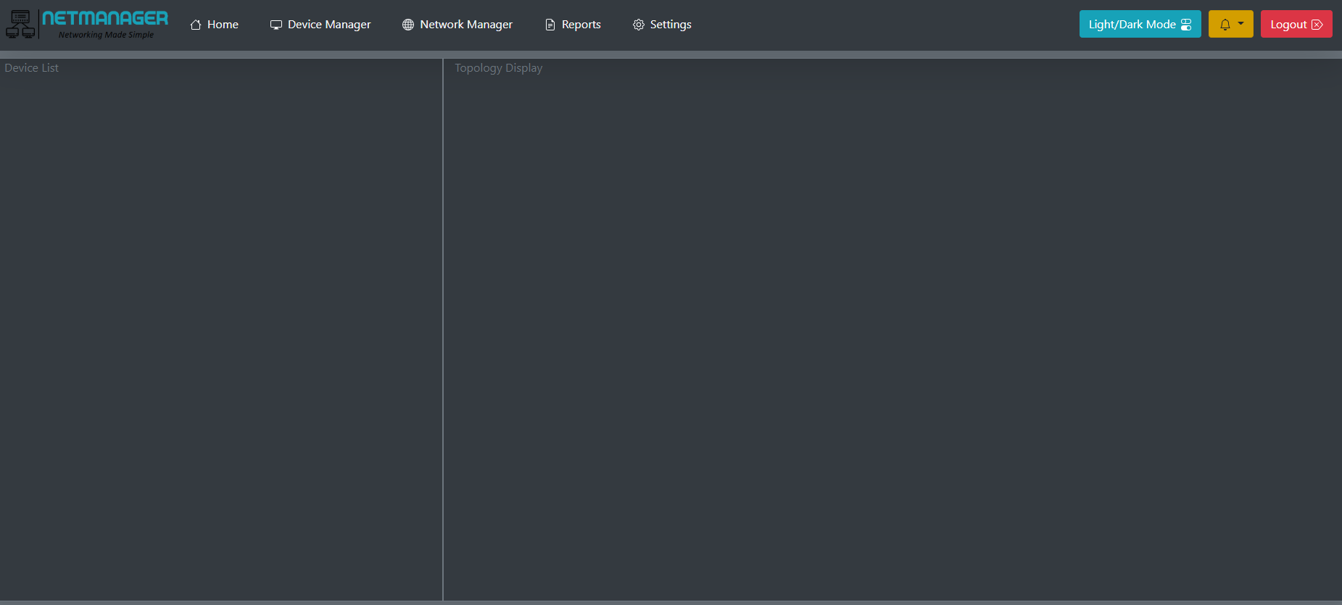
Home Page

Slide 7
Next Sprint
Finish building webpages
Setup backend
Python network scripts

